Slide 1
Chemical Reactions
Jason R. Mayberry, PhD

Slide 2
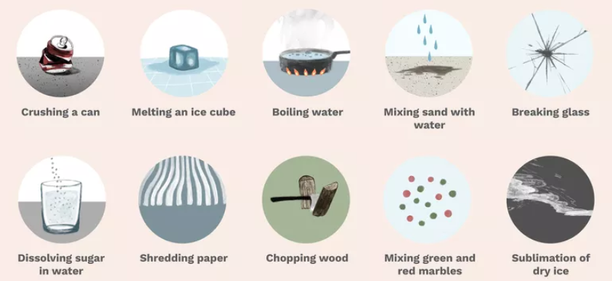
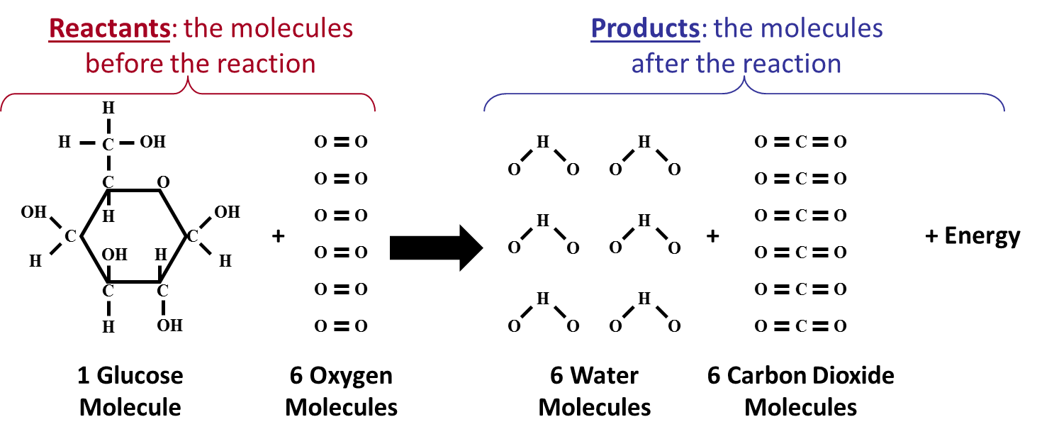
Physical Changes vs. Chemical Reactions
Physical Changes
Change to the form of a substance (size, shape, energy, etc.) but no new molecules are formed.
Chemical Reactions
Changes where atoms in existing molecules (reactants) rearrange to form different molecules (products).
Original molecules are not recoverable by normal means.
C₆H₁₂O₆ + 6O₂
6H₂0 + 6CO₂+ Energy

Slide 3
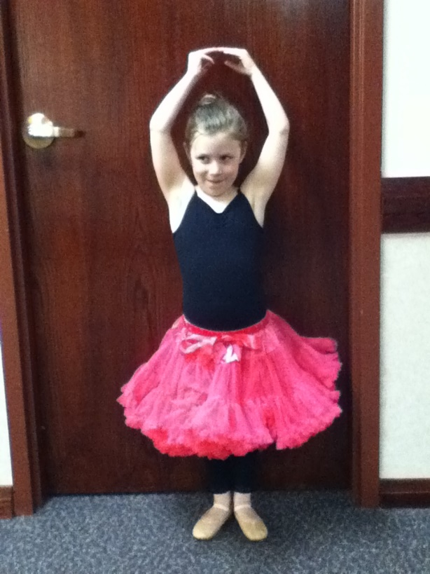
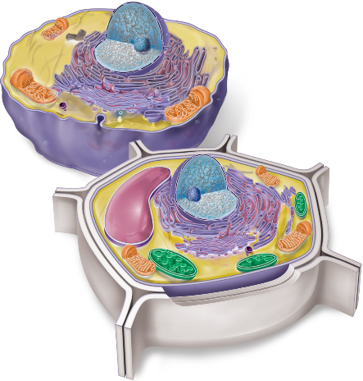
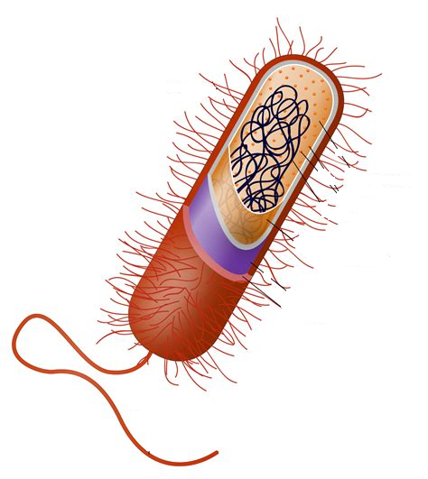
Some Cool Chemical Reactions
As you watch these chemical reactions, note which ones could be mistaken for life.
https://www.youtube.com/watch?v=FofPjj7v414
https://www.youtube.com/watch?v=0Bt6RPP2ANI
But what is the most amazing chemical reaction of all?
Life
Cells: Smallest living thing.
Formed when chemistry of a contained system becomes self sustaining.
How would you define life?

Slide 4
Making and Breaking Macromolecules
Chemical Reaction: process during which some of the bonds between atoms in one or more molecules break, and/or new bonds are formed connecting the atoms in a different way.
Reactants: the molecules before the reaction
Products: the molecules after the reaction
H
H
C
OH
O
O
O
O
O
C
O
C
O
O
O
H
H
H
H
O
C
O
OH
H
OH
O
O
O
O
O
C
O
C
C
+
+
+ Energy
H
OH
H
H
O
O
H
H
H
H
O
C
O
C
C
O
O
O
O
O
C
O
H
OH
O
O
H
H
H
H
O
C
O
1 Glucose Molecule
6 Oxygen Molecules
6 Water Molecules
6 Carbon Dioxide Molecules
Reaction Equation (Summary):
C₆H₁₂O₆ + 6O₂
6H₂O + 6CO₂+ Energy
Virtually all life processes have chemical reactions at their foundation.
Notes:
All life processes have chemical reactions at their foundation.

Slide 5
Reaction equation: shorthand summary of the chemical reaction
Reactants: Molecules to the left of the arrow
Products: Molecules to the right of the arrow
Coefficients: number in front of a molecular formula indicating the number involved in a chemical reaction (assumed 1 if missing)
Subscripts: number to the right of each atom in a molecular formula indicating how many of each atom are in the molecule
Balanced: Number of each atom on the left is unchanged on the right
C₆H₁₂O₆ + 6O₂
6H₂0 + 6CO₂+ Energy
The chemical reaction below takes place between ionic compounds. Write the reaction equation summarizing this reaction.
[Na⁺¹]
[Br⁻¹]
[Na⁺¹]
[Cl⁻¹]
+
[Cl⁻¹]
[Ba⁺²]
[Cl⁻¹]
+
[Br⁻¹]
[Ba⁺²]
[Br⁻¹]
[Na⁺¹]
[Br⁻¹]
[Na⁺¹]
[Cl⁻¹]
2NaBr + BaCl₂ → 2 NaCl + BaBr₂

Slide 6
Where Does the Energy Come From
H
Chemical Energy: the energy electrons hold in a bond
Each Bond represents 2 electrons
Energy state of electrons in the bonds is variable
High Energy Bonds
Require an input of energy to form
Tend to be less stable/more easily broken
Release energy when broken
Lower energy Bonds tend to be more stable
During a Chemical Reaction, electrons move to different energy levels and so absorb or release energy
H
C
OH
C
O
HO
H
OH
C
C
OH
H
H
H
C
C
H
OH
1 Glucose Molecule
1
2
3
4
5
6
7

Slide 7
Energy Dynamics of Chemical Reactions
EXERGONIC REACTIONS:
Reaction in which the reactants have more energy than the products (Exothermic)
Energy is released (i.e. exits the molecules)
ENDERGONIC REACTIONS:
Reaction in which the reactants have less energy than the products (Endothermic)
Energy is required (i.e. Enters the molecules)
$$C6H12O6+6O2⟶6C02+6H2O$$
$$6C02+6H2O⟶C6H12O6+6O2$$
R
EA
Endergonic
P
Free Energy
Free Energy
EA
P
Energy
Energy
R
Exergonic
Time
Time
Energy of Activation (EA): Energy needed to get a reaction started

Slide 8
Chemical Reactions…what’s actually happening
Molecules only react when collide with:
Right 3-D orientation
Enough Energy
What if something could help the reactants to get into their intermediate states?
H O
H
H O
H
H O
H O
H
H
H
O H
No Reaction
H
H O
H
O H
No Reaction
H
O H
H
H
O
H
H O
H
O H
Reaction!
H
O H
H
H O

Slide 9
Energy Dynamics of Chemical Reactions
Exergonic Reaction: Reaction in which the reactants have more energy than the products (Exothermic)
Energy is released (i.e. exits the molecules)
Endergonic Reaction: Reaction in which the reactants have less energy than the products.
Energy is required (i.e. Enters the molecules)
R
EA
P
With a catalyst
With a catalyst
EA
Free Energy
Free Energy
P
Energy
Energy
R
Exergonic
Endergonic
Time
Time
Energy of Activation (EA): Energy needed to get a reaction started
Often supplied by heat from surroundings.
Along with concentrations of R and P, determines the Rate of a reaction
Catalyst: chemical that speeds helps a reaction to occur more quickly
Helps reactants get into their intermediate state.
Lowers the energy of activation
Is not altered in the reaction
Enzyme: an organic molecule that functions as a catalyst (usually proteins, sometimes RNA)

Slide 10
Intermediate State of Chemical Reactions
Intermediate State:
In-between state between Reactants and Products
Higher in Energy than either Reactants or Products
Energy of collision must be sufficient to cause intermediate state to form.
Intermediate State
Reactants
H
H O
H
H O
R
Free Energy
Intermediate State
H
H
O
H
H
O
P
Energy
Exergonic
Time
Products
H
H
O
H
O
H

